Slide 1

UCLA Admission Logistic Regression
Michael Lin

Slide 2
Problem Statement
Using a small sample size of UCLA Graduate School Admission dataset from an unknown timeframe – we aim to predict whether an applicant would get admitted into the school based on his/her application information including GRE Score (quantitative), GPA (quantitative), and the Prestige Rating (qualitative and subjective) of their previous school .

Slide 3
Process
1. Preparing
a) Drop Null Values
b) Created Dummy Variables
c) Created Intercept
2. Analyzing
a) Data Summary
b) Plotting
3. Building Model
a) Logistic Regression

Slide 4
Process
1. Preparing
a) Drop Null Values
b) Created Dummy Variables
c) Created Intercept
2. Analyzing
a) Data Summary
b) Plotting
3. Building Model
a) Logistic Regression

Slide 5
Data Summary
The mean score for GPA and GRE for admitted applicants are higher.
Proportionally, the odds of being admitted is higher for higher ranking (Prestige 1 is the highest ranking, and Prestige 4 is the lowest ranking.)
 | Not Admitted | Admitted
GPA (mean) | 3.347 | 3.489
GRE (mean) | 573.53 | 618.57
Prestige 1 (ct) | 28 (45.90%) | 33 (54.10%)
Prestige 2 (ct) | 95 (64.19%) | 53 (35.81%)
Prestige 3 (ct) | 93 (76.86%) | 28 (23.14%)
Prestige 4 (ct) | 55 (82.09%) | 12 (17.91%)

Slide 6
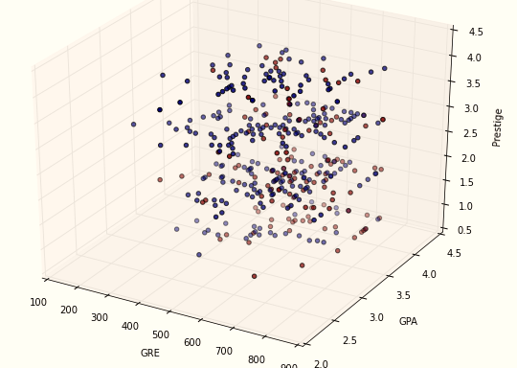
Data Visualization
Admitted
Not Admitted

Slide 7
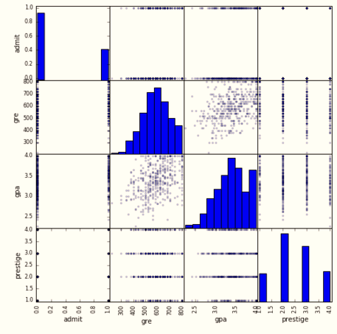
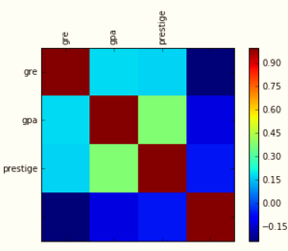
Checking for Correlations

Slide 8
Process
1. Preparing
a) Drop Null Values
b) Created Dummy Variables
c) Created Intercept
2. Analyzing
a) Data Summary
b) Plotting
3. Building Model
a) Logistic Regression

Slide 9
e^{Coefficients} and Standard Error

Slide 10
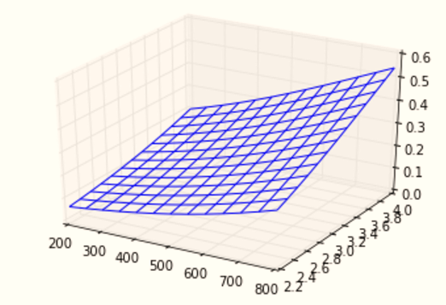
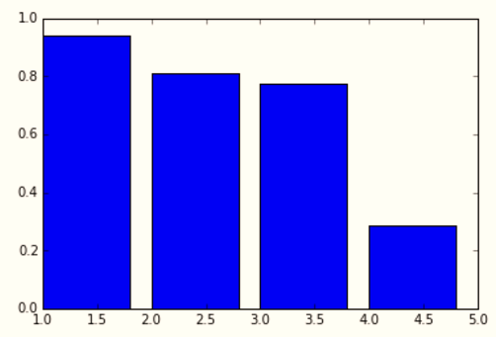
Result Visualization
Mean Admission Probability
GRE (x-axis) vs. GPA (y-axis)
Mean Admission Probability
Prestige 1 (left) through Prestige 4 (right)

Slide 11
Future Steps
Obtain larger sample size for training, validation and testing
Other classification models
Check interactions (highly possible)
Check non-linear relationship

Slide 12
Thanks!

